Slide 1
Hybrid Generative AI-Based Resume Analysis System Using Supervised, Unsupervised and Deep Learning Techniques in Python
NAME: PRIYADARSHINI R
REG NO: 22BDS0155
VELLORE INSTITUTE OF TECHNOLOGY

Slide 2

Introduction
Artificial intelligence is transforming recruitment systems by automating resume evaluation. Traditional manual screening is inefficient and prone to bias. This project proposes A hybrid ai-based system integrating machine learning, deep learning, and generative ai to improve resume analysis.

Slide 3

Problem Statement
Manual screening requires high human effort
Large number of resume submissions
No intelligent resume improvement feedback
Lack of skill-based grouping

Slide 4

Objectives
Predict job suitability using supervised learning
Cluster resumes using unsupervised learning
Improve resume quality using generative AI
Perform statistical evaluation of model

Slide 5
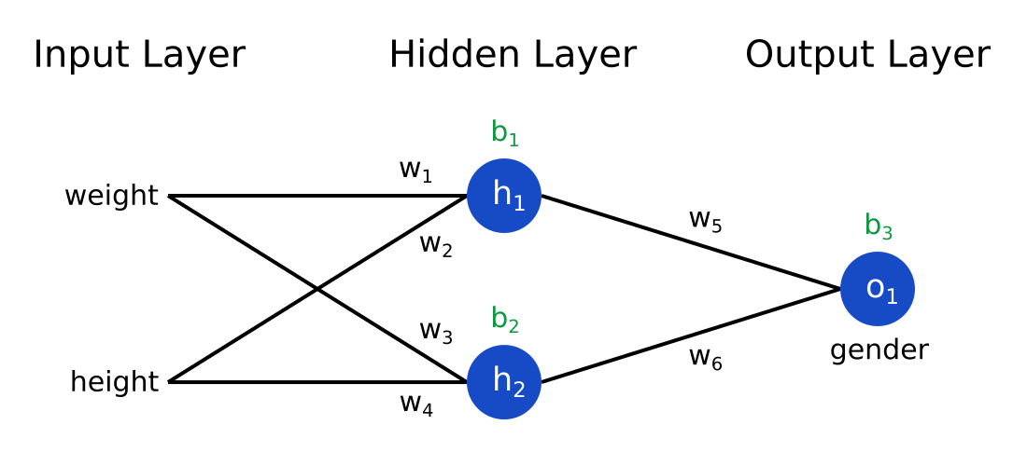
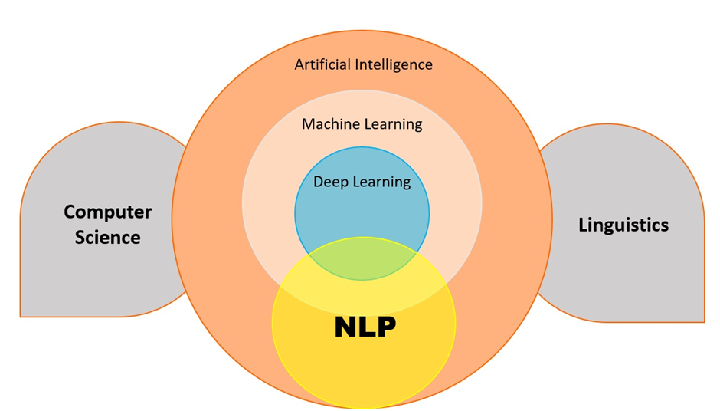
Literature Insight
Machine learning widely used for text classification
Deep learning improves contextual understanding
Generative AI enables intelligent content enhancement
Hybrid models improve decision-making accuracy

Slide 6


Technologies Used
Programming language : PYTHON
Libraries:
1.Pandas
2.Numpy
3.Nltk
4.Scikit-learn
5.Tensorflow / keras
6.Matplotlib

Slide 7
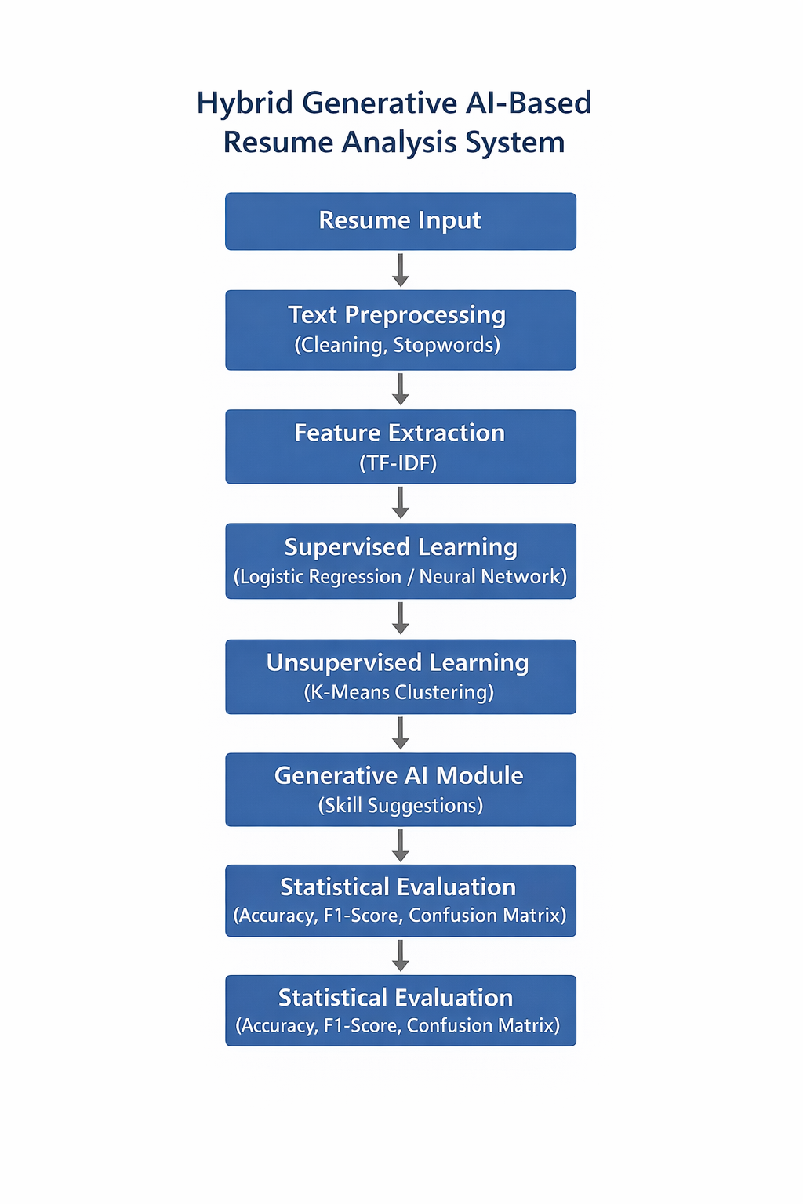
System Architecture
1. Resume input module
Accepts resume text as PDF
Converts document into raw text format
2. Text preprocessing
Lowercasing
Removing special characters
Stopword removal
Tokenization
3. Feature Extraction
TF-IDF vectorization
Converts text into numerical Features
Represents word importance
4. Supervised learning
Logistic regression / neural network
Uses labeled training data
Predicts job suitability
5. Deep learning component
Artificial neural network
Captures complex feature relationships
Improves classification accuracy
6. Unsupervised learning module
K-means clustering
Groups resumes by skill similarity
No labeled data required
7. Generative AI module
Skill gap identification
Resume improvement suggestions
Intelligent feedback generation
8. Statistical Evaluation
Accuracy
Precision
Recall
F1 Score
Confusion Matrix

Slide 8
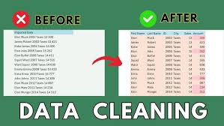
Data Preprocessing
Text cleaning
Lowercasing
Removing special characters
Stopword removal
Tokenization
Example:
Raw: "python!!! Machine learning???“
Cleaned: "python machine learning"

Slide 9
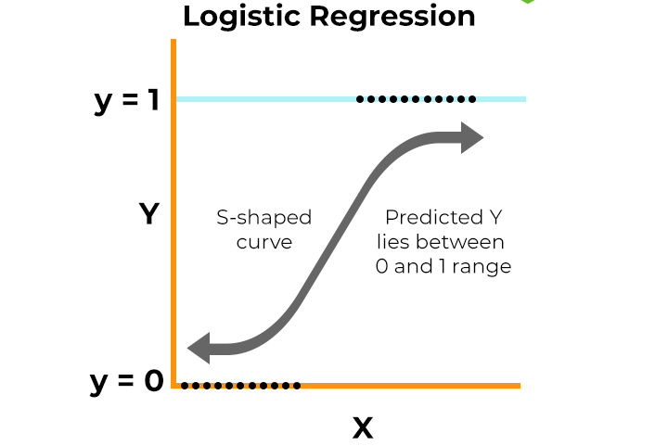
Supervised Learning
Algorithm used: Logistic regression
Process:
1. Labelled dataset
2. Train-test split
3. Prediction output
Output:
1. Suitable / not suitable
2. Probability score

Slide 10
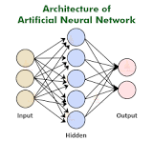
Deep Learning Model
Content:
1.Artificial neural network
2. Dense layers
3. Activation: Relu, sigmoid
4. Captures complex feature relationships

Slide 11
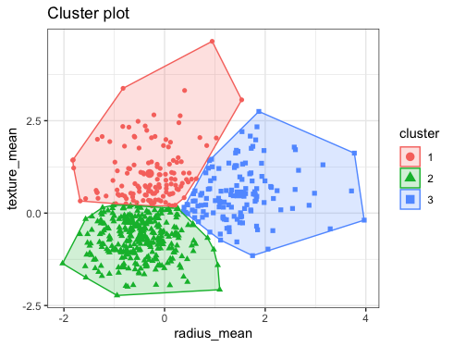
Unsupervised Learning
Content:
1. K-means clustering
2. Groups resumes by skill similarity
3. No labeled data required

Slide 12
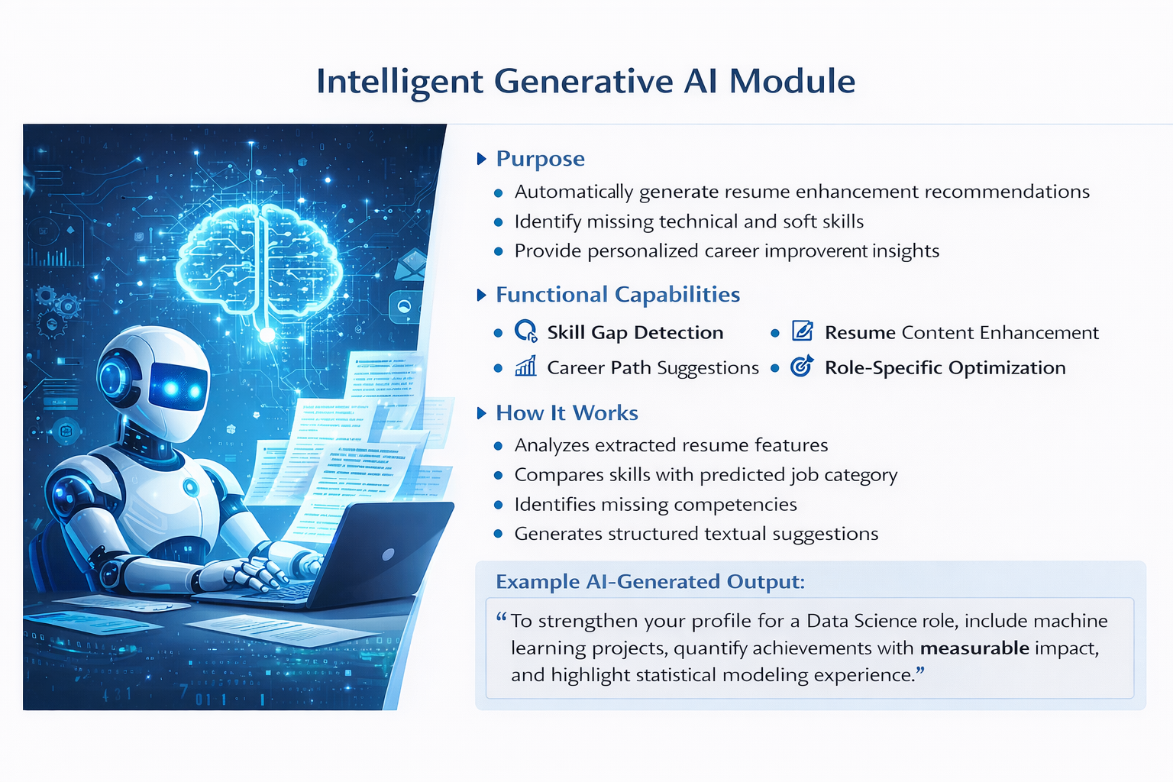
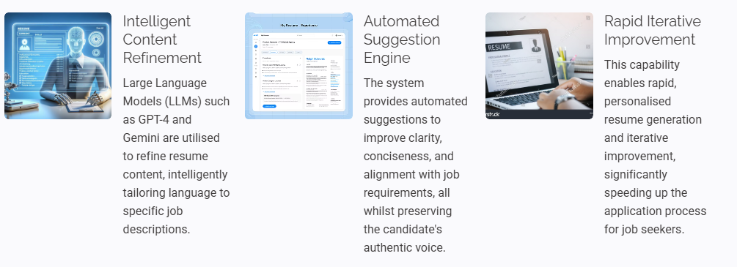
Intelligent Generative AI Module

Slide 13
METRICS
Content:
Accuracy = (TP + TN) / Total
Precision = TP / (TP + FP)
Recall = TP / (TP + FN)
F1 score
Confusion matrix

